Slide 1
INVESTMENT ASSIGNMENT SUBMISSION
Name: Prateek Pande

Slide 2
Investment Analysis for Spark Funds
Introduction - Spark Funds is an asset management company who wants to make invest in few companies based on below criteria.
Business Objectives – The objective is to identify the best sectors, countries, and a suitable investment type for making investments based on strategy where 'where most investors are investing’.
Goals of Data Analysis –
Investment Type Analysis – Spark Funds want to choose fund type that is best suited for investment.
Country Analysis – Want to invest in countries which are most heavily invested in past.
Sector Analysis – Want to study trend of investment made in eight main sectors to decide distribution of funds based on that.
Minor Constraints –
Spark Funds wants to invest 5 – 15 million USD per round of investment.
It wants to invest only in English

Slide 3
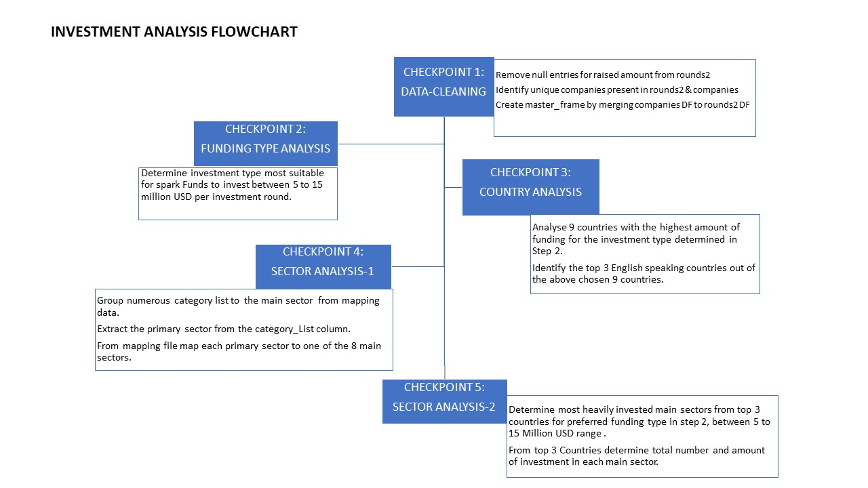
Use flow chart

Slide 4
Investment Analysis Approach Checkpoints
Checkpoint 1 : Data Cleaning
Create data-frame companies and rounds2 from companies.txt and rounds2.csv respectively.
Remove rows with null entries for raised_amount_usd from round2 data-frame.
Determine unique companies from rounds2 and companies data-frame.
Merge the two data frames so that all variables (columns) in the companies frame are added to the rounds2 data frame in master_frame.
Checkpoint 2 : Funding Type Analysis
Create new data-frame after filtering master_frame for preferred funding types – venture, angel, seed and private-equity.
Calculate the most representative value of the investment amount for each of the four funding type.
For preferred funding types Find investment between 5 to 15 million USD for each investment round.
From above venture funding is most preferred funding type.

Slide 5
Checkpoint 3 : Country Analysis
1. Spark Funds wants to see the top nine countries which have received the highest total funding. Determine top 9 countries with highest total funding in the preferred funding type.
2. For the chosen investment type, make a data frame named top 9 with the top nine countries.
USA 108531347515.00
GBR 5436843539.00
CHN 5016561053.00
CAN 3647009578.00
IND 2976543602.00
ISR 2840305951.00
FRA 2112425453.00
DEU 1765026223.00
3. From above top 9 countries choose top 3 English speaking countries using - https://en.wikipedia.org/wiki/List_of_territorial_entities_where_English_is_an_official_language
4. Thus USA, GBR and CAN are the top 3 countries for preferred investment type.

Slide 6
Checkpoint 4: Sector Analysis 1
Few of the companies have multiple category_list separated by "|". We need to split category list and take first entry and primary_sector.
Use the mapping file 'mapping.csv' to map each primary sector to one of the eight main sectors –
"Automotive & Sports", "Cleantech / Semiconductors", "Entertainment", "Health", "Manufacturing", "News, Search and Messaging", "Others", "Social, Finance, Analytics, Advertising"
Determine merged data frame with each primary sector mapped to its main sector
Checkpoint 5: Sector Analysis 2
1. Create three separate data frames D1, D2 and D3 for each of the three countries containing the observations of funding type FT falling within the 5-15 million USD range. The three data frames should contain:
1. All the columns of the master_frame along with the primary sector and the main sector
2. The total number (or count) of investments for each main sector in a separate column
3. The total amount invested in each main sector in a separate column
2. Using the three data frames, you can calculate the total number and amount of investments in each main sector.
3. Create Data-Series which contains required amount and count for all three countries.
4. Determine total number of investments in all three countries.
5. Total amount of investments in all three countries.
6. Top Sector name (no. of investment-wise)
7. Number of investments in top sector.
8. For top sector count-wise which company received the highest investment
9. For second best sector count-wise which company received the highest investment.

Slide 7
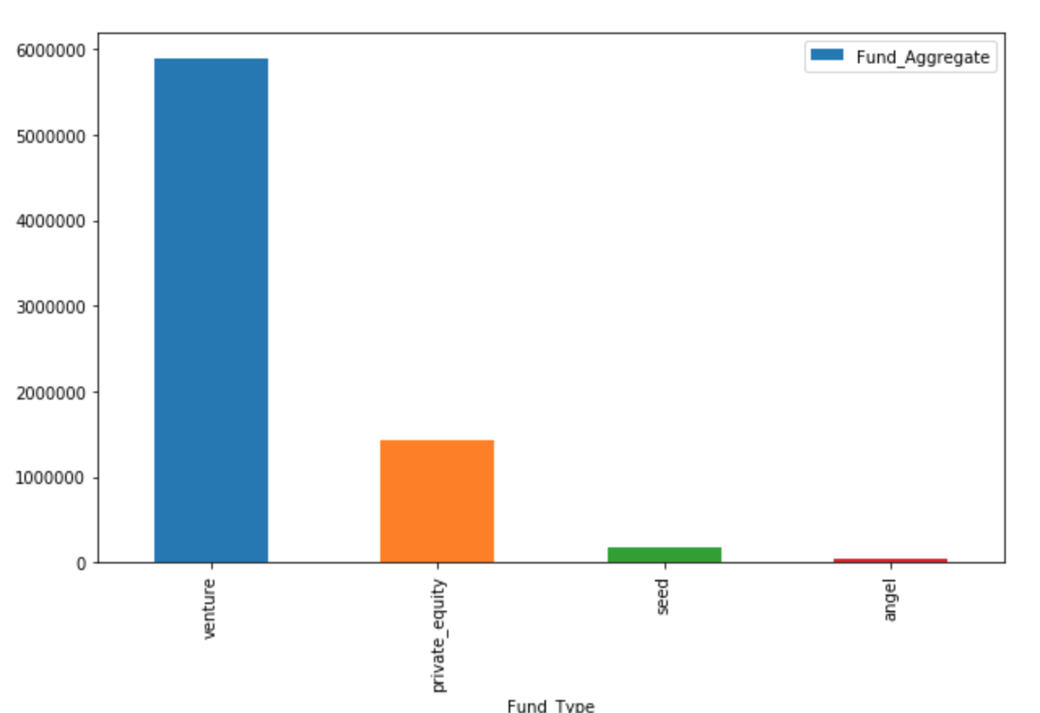
A plot showing the fraction of total investments (globally) in venture, seed, angel, and private equity, and the average amount of investment in each funding type.
Plot 1

Slide 8
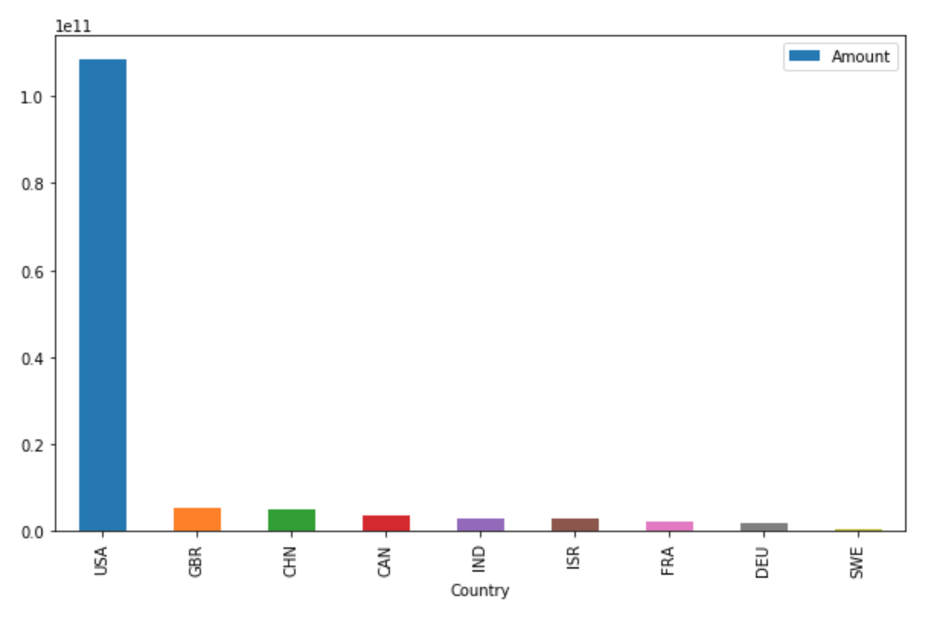
A plot showing the top 9 countries against the total amount of investments of funding type FT.
Plot 2

Slide 9
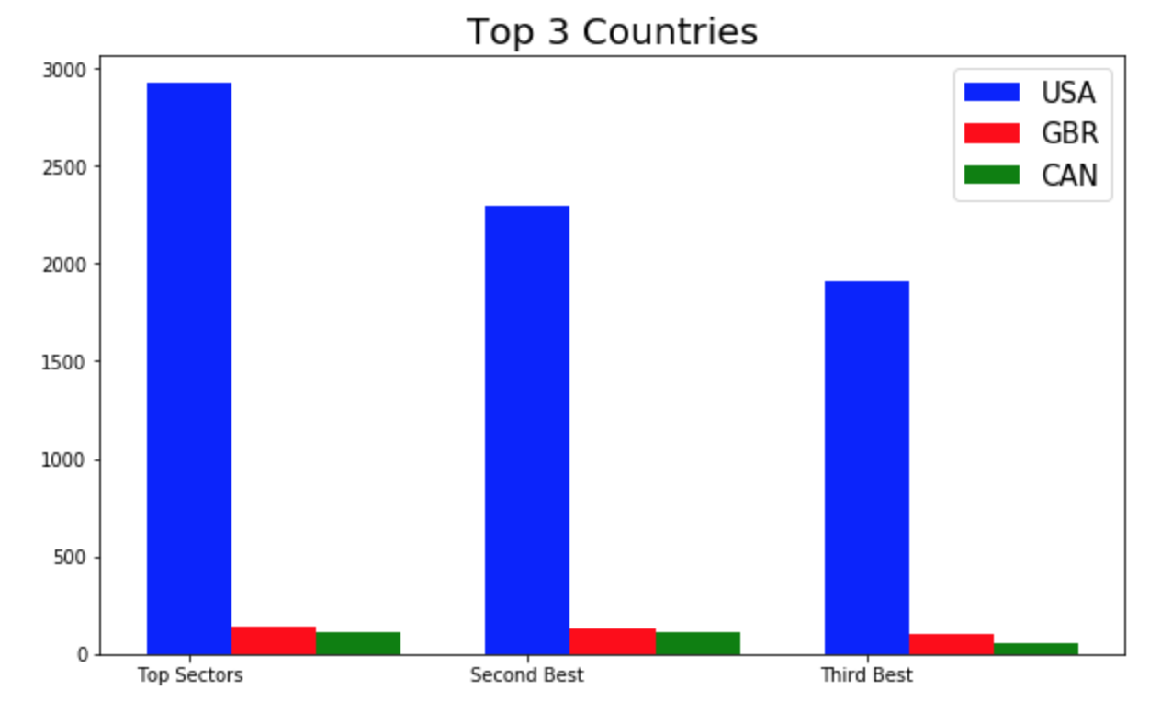
A plot showing the number of investments in the top 3 sectors of the top 3 English speaking countries on one chart
Plot 3

Slide 10
Conclusion
Following conclusion can be drawn from analysis for Sparks Funds -
Best Fund Type for investment in range of 5 to 15 million USD – Venture
Top 3 English speaking countries to make investment in venture fund – USA, GBR and CAN.
Best Company for USA count wise –
Virtustream
Biodesix
Best Company for GBR count wise –
Electric_cloud
EUSA Pharma
Best Company for CAN count wise –
Fresco Microchip
QuickPlay Media

